Slide 1
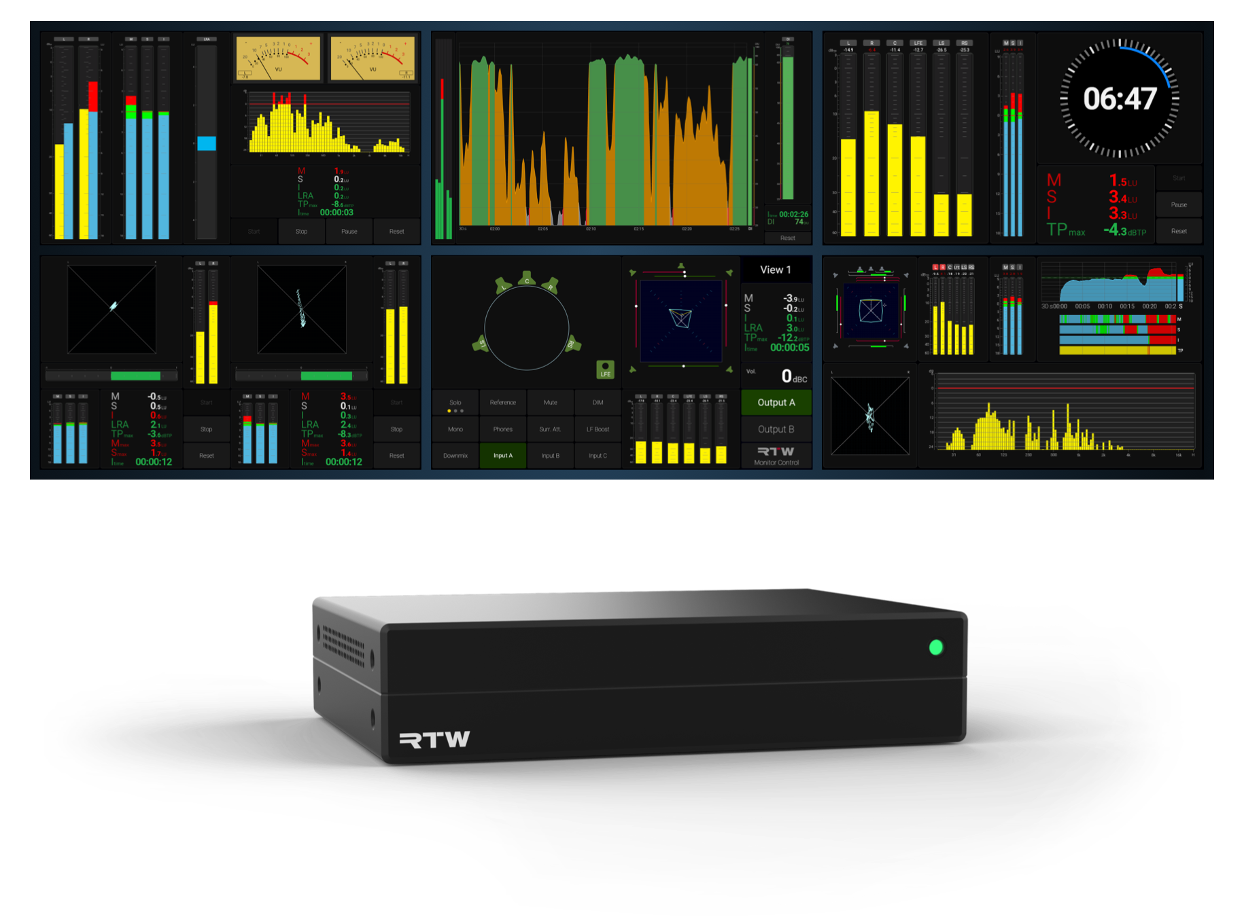
TMxCore
Immersive. Dialog Intelligent. Compliant

Slide 2
Background
What is it?
RTW’s latest high-end, high-performance broadcast and pro audio metering platform
AI-assisted tools for advanced dialog intelligibility analysis
Immersive audio metering for 5.1 surround and 7.1.4 formats - and beyond
Fully compliant suite of loudness and metering instruments
Network display: view your meters in any browser, anywhere
DisplayPort output for direct connection to any monitor - up to 4K: 3840 × 2160
Network-ready with RAVENNA®, AES67, ST 2110, Dante®, and AES I/O options
Designed for modern workflows

Slide 3
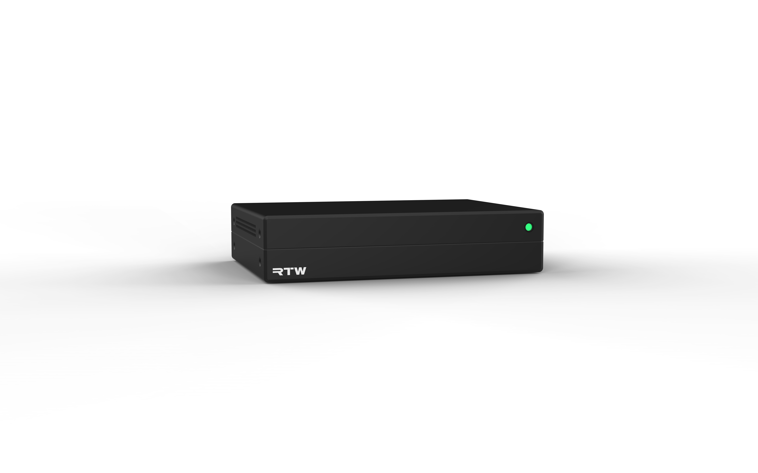
User Configurable 5” Touch Display

Slide 4
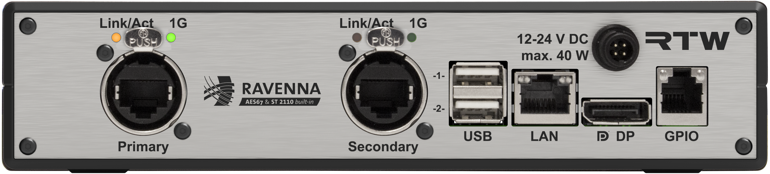
USB for touchscreen, mouse/keyboard, harddrive
User Configurable 5” Touch Display
Audio Over IP or Traditional Digital I/O
LAN connection for network display, control, OSC
DisplayPort for external display (4K: 3840 × 2160)
GPIO for external control

Slide 5
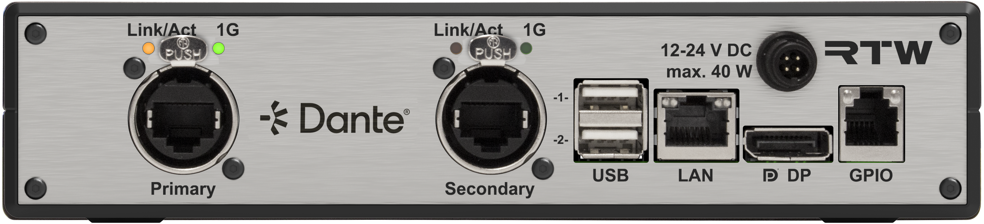
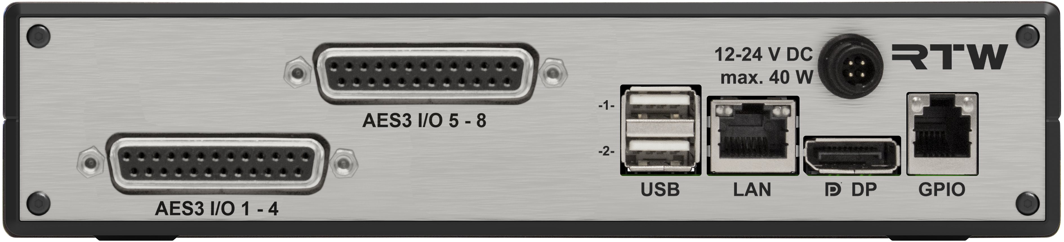
Features
Multiple I/O Options
USB, GPIO, LAN Control, DisplayPort
RAVENNA ST2110/AES67 NMOS
  32 Channels
DANTE
  32 channels
AES16
  16 channels sub-D 25

Slide 6
Title
Instruments
The most comprehensive metering engine ever from RTW

Slide 7
Features
The instruments you know
Reliable, Classic
Built on the trusted TouchMonitor TM7/TM9
Levels, frequency, loudness compliance, phase issue detection

Slide 8
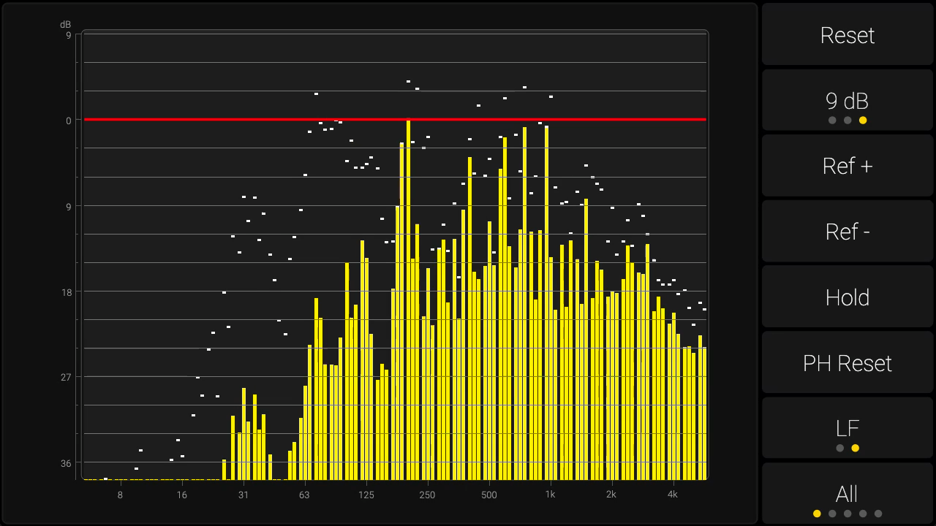
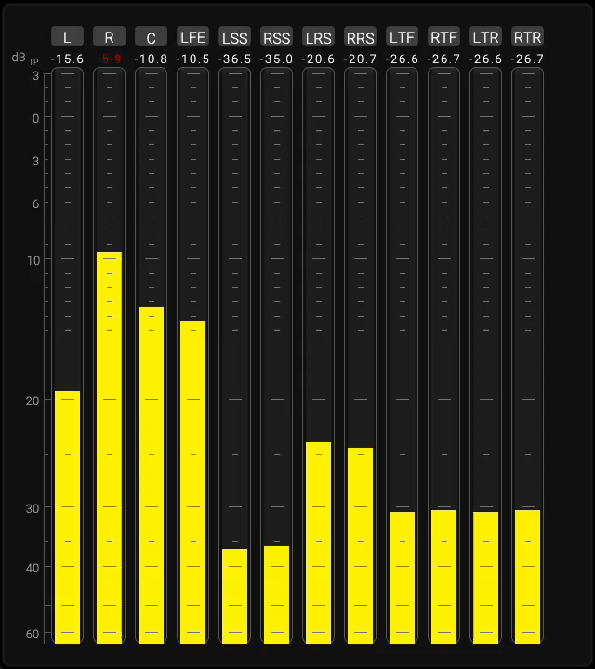
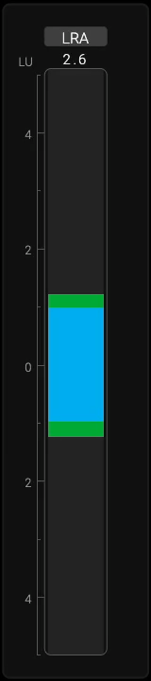

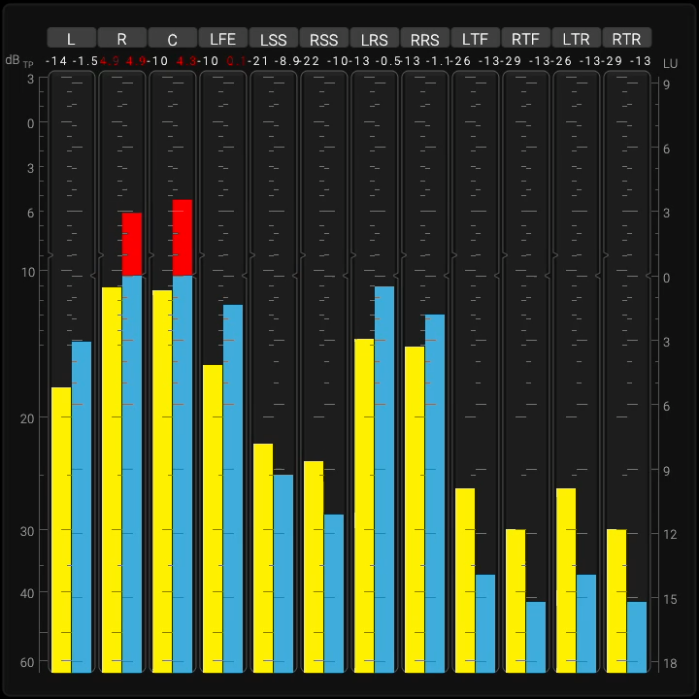
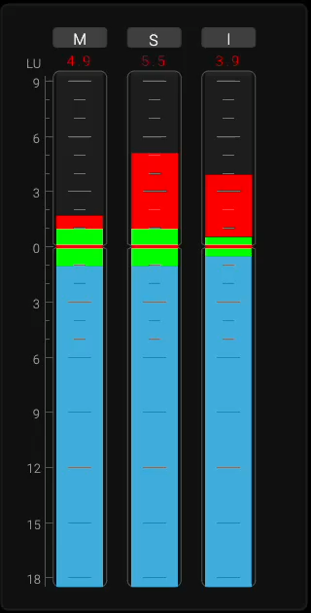
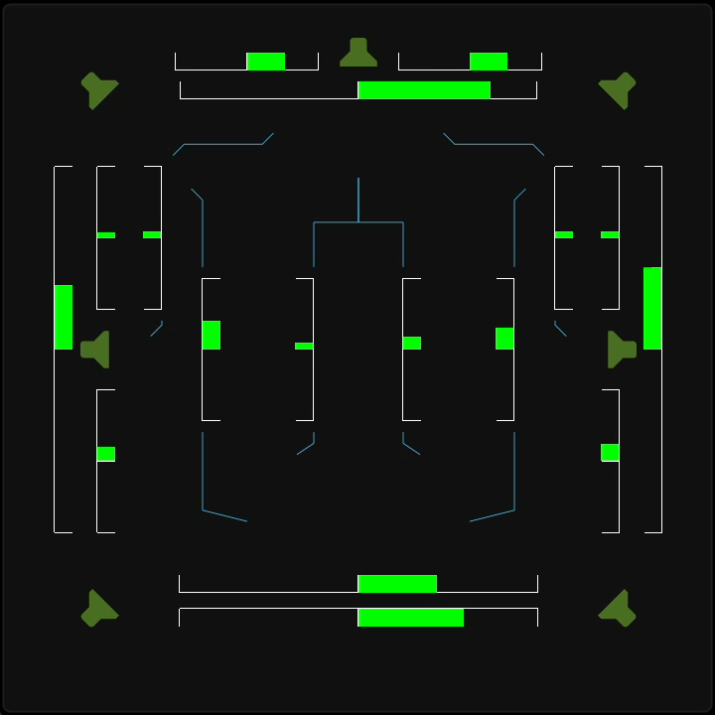
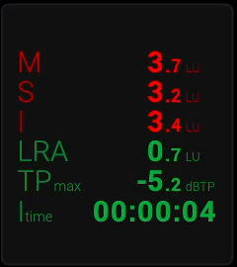
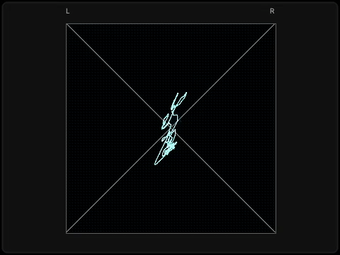
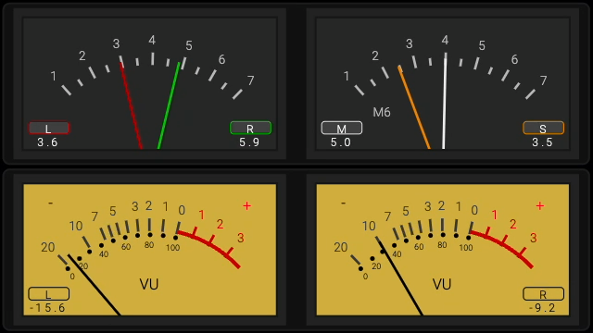
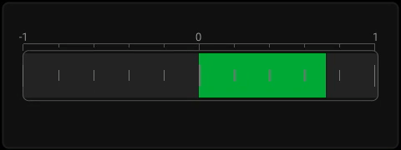

Slide 9
Features
Immersive Metering
Surround and Immersive formats. 5.1, 7.1.4 Atmos - and beyond
Commonly used by broadcasters around the world
Spatial Balance, Relationship between multiple speakers, detect phase issues
Correlation problems with LFE channels

Slide 10
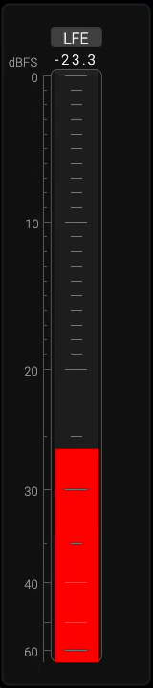
Features
New: LFE Bleed
Avoid high frequency content in your LFE Channel
    Monitors energy above a defined threshold (120 Hz by default) with a compact dBFS bargraph, highlighting any leakage into the LFE channel(s).
    Recommends limiting the LFE frequency range to maintain compatibility and avoid distribution problems.
    Ensures that unwanted high-frequency content is not present in the LFE channel(s), preventing playback issues across encoders and binaural formats.

Slide 11
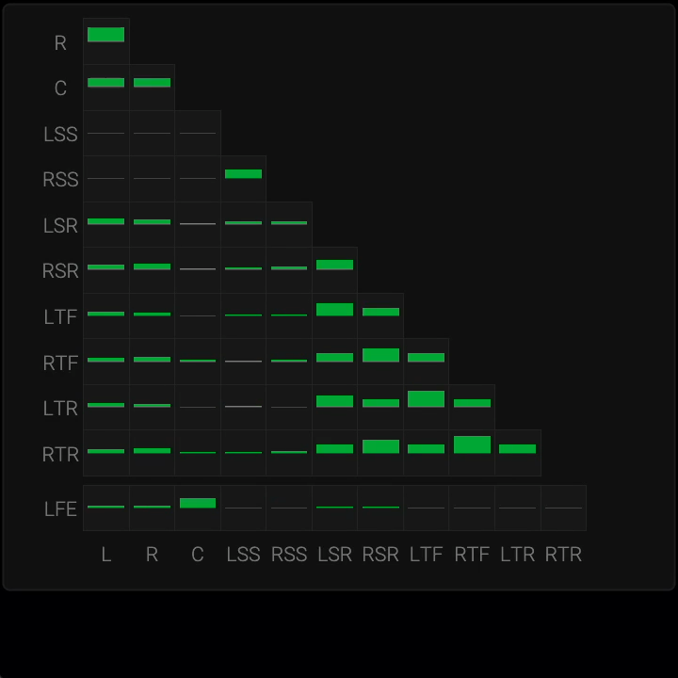
NEW
Features
New: The Matrix Correlator
Detect phase issues in a complex channel setup
    Displays detailed phase relationships between all channels, from simple stereo up to complex 30.2 formats
    Provides a comprehensive overview of inter-channel correlations for precise monitoring
    Enables fast detection of phase conflicts within a mix, ensuring accuracy and consistency across formats

Slide 12
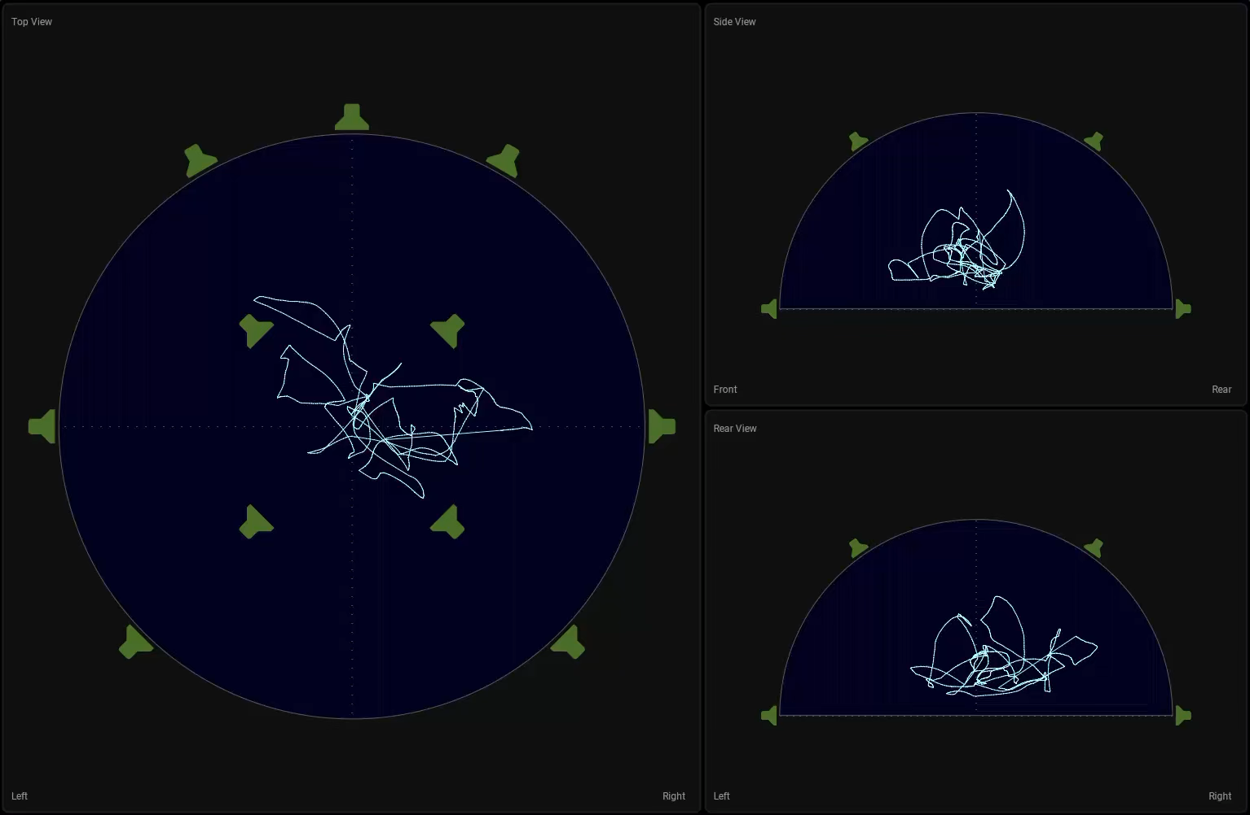
NEW
Features
New: The Polar Scope
Vectorscope extended. Monitor:
  Spatial coherence
  Channel delay mismatches
  Phase conflicts
  Front/rear balance
  Spatial image width and depth
  Energy Distribution

Slide 13
Title
Dialog Intelligibility
Hottest topic in Broadcast

Slide 14
Features
Dialog Intelligibility
The most critical challenge in dialog sound today
Severe issues reported by end listeners
Multiple, often conflicting, approaches to measuring the problem
Gathering insights and recommendations for the Loudness Blog
Driving efforts toward a unified industry standard

Slide 15
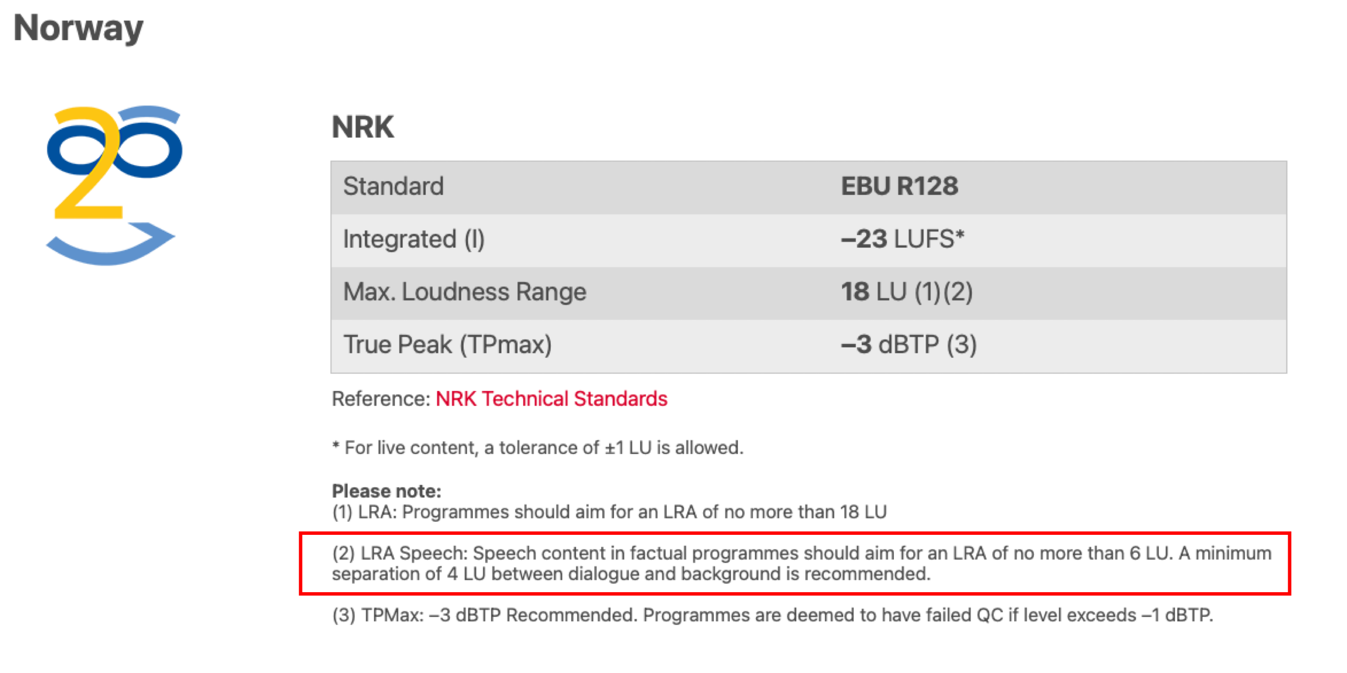
Features
Dialog Intelligibility:
Loudness Based Approach
Dolby Dialog Intelligence: Dialog Gated Loudness Measurement (Netflix)
LDR: Loudness-to-Dialog Ratio. Specified in EBU R128 Supplement 4.
BDR: Background-to-Dialog Ratio. Ratio between the dialog and background audio. NRK (Norway), BBC, ARD, W3C and others.

Slide 16
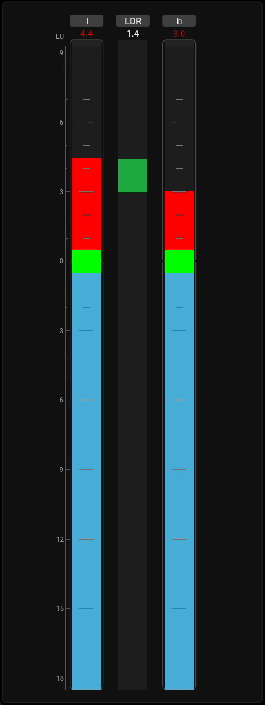
NEW
Features
New: The Ratio Instrument
Keep an Eye on the Dialog Ratio
    Displays the ratio between two measurements, enabling precise evaluation of ratio and consistency.
    Supports key use cases such as Loudness-to-Dialog Ratio (LDR) and Background-to-Dialog Ratio (BDR) within a single source.
    Compares loudness across different sources or renderings (e.g., pre/post processing, immersive vs stereo), revealing the impact of processing and format changes

Slide 17
NEW
Features
The Dialog Intelligibility Instrument
Eyes on Dialog Intelligibility
    Provides AI-driven, objective measurement of dialogue clarity, developed in cooperation with Fraunhofer IDMT and based on over nine years of research.
    Delivers real-time visual feedback that helps engineers balance dialogue, effects, music, and background noise with confidence.
    Available as a license option for TMxCore, giving broadcasters and audio professionals a proven solution for consistent dialog intelligibility across formats.

Slide 18
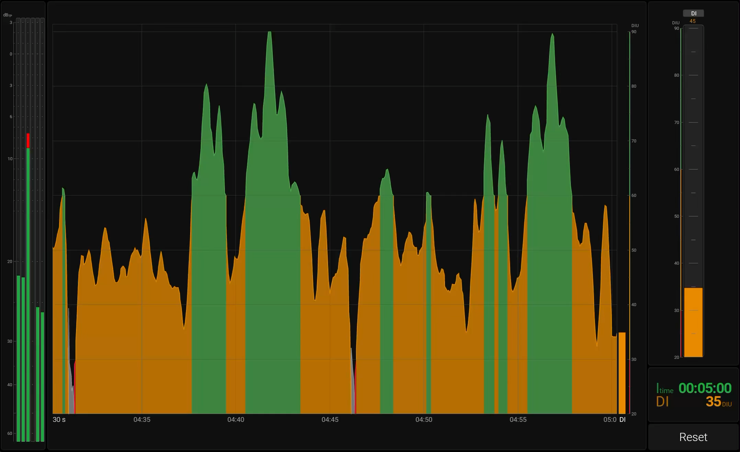
NEW

Slide 19
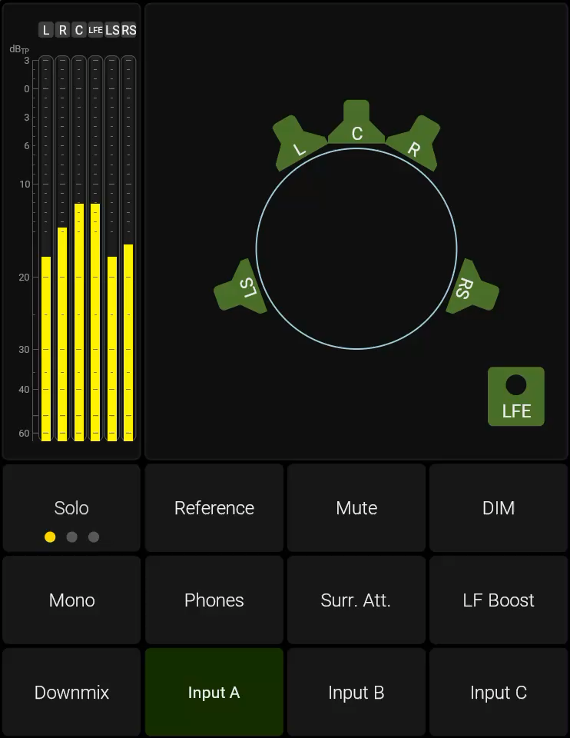
NEW
Features
Monitor Control
Speaker Level Control
Mute, dim, reference level, input selection, downmix, bass management
Speaker Calibration with Level, Delay, Polarity and 8-Band EQ
Support for stereo- surround and -immersive speaker formats including 5.1 and 7.1.4

Slide 20

NEW
Features
External Logging & Integration
LAWO HOME Integration
Prometheus & Grafana Monitoring
Genelec Smart IP Speaker Control
NMOS IS-07 Event Support

Slide 21
Features
Action Instrument & OSC
Support for Open Sound Control
    Create customizable buttons with user-defined size, position, and color.
    Trigger actions via Open Sound Control (OSC over TCP/UDP) or HTTP.
    Two-way OSC: TMxCore also reacts to incoming commands such as preset recall, loudness control, reference level, and mic gain.
    Actions is integrated in current buttons (Mute, Dim, etc.), too

Slide 22
Features
Wall Clock
Eyes on the Clock
  Provides an always-on wall-clock reference in a broadcaster-friendly design
  Offers four styles: digital, analog modern (no numbers), analog classic (with numbers), and broadcast focus with a red seconds ring
  Support for Offset (Time Zones)
  Ensures maximum readability and flexibility, integrating accurate time display directly into the monitoring workflow

Slide 23
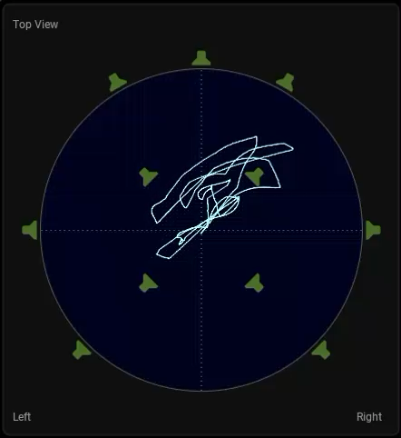
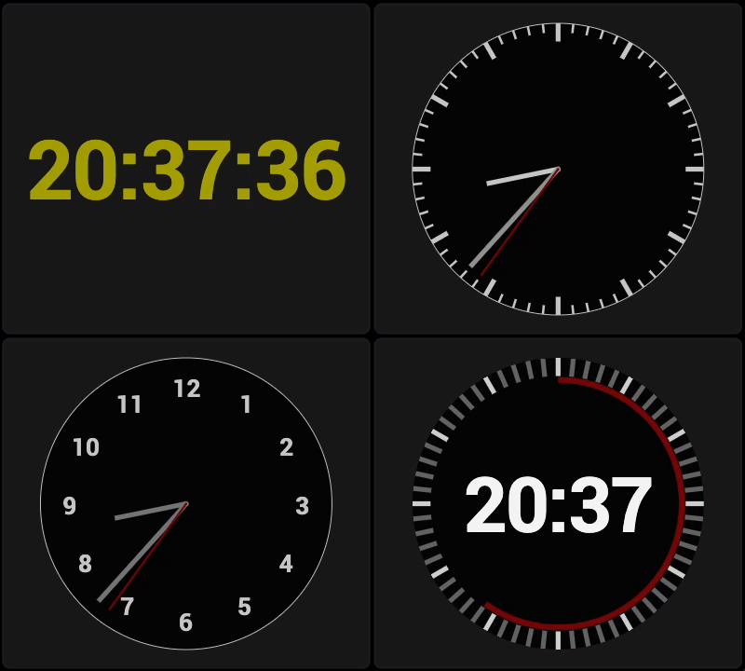
NEW
Matrix Correlator
Polar Scope
Ratio
LFE Bleed
Dialog Intelligibility
Clock
Action: OSC

Slide 24
Features
Delay Compensation
Advanced dialog-gated loudness and dialog intelligibility measurements may add up to 2 seconds of latency, required for reliable detection
RTW’s metering engine features built-in delay compensation to keep all meters visually aligned
Audio outputs (new) remain time-aligned, ensuring playback corresponds precisely with the display
Good for comparison

Slide 25
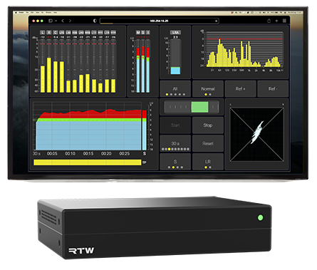

Features
Network Display
Eyes on your Audio from Everywhere
  View real-time audio measurements anywhere on the local network using a standard web browser, without extra hardware
  “Local network” = any location on the planet with a VPN connection
  Monitor flexibly from control rooms, production suites, or multiple workstations
  Expand with additional licenses, each adding a new metering instance (screen) to your setup
  Latency: 1 frame (20ms) plus network latency

Slide 26

Features
Rack Mount Kit

Slide 27
Title
Customers & Applications
Who will benefit from TMxCore?

Slide 28
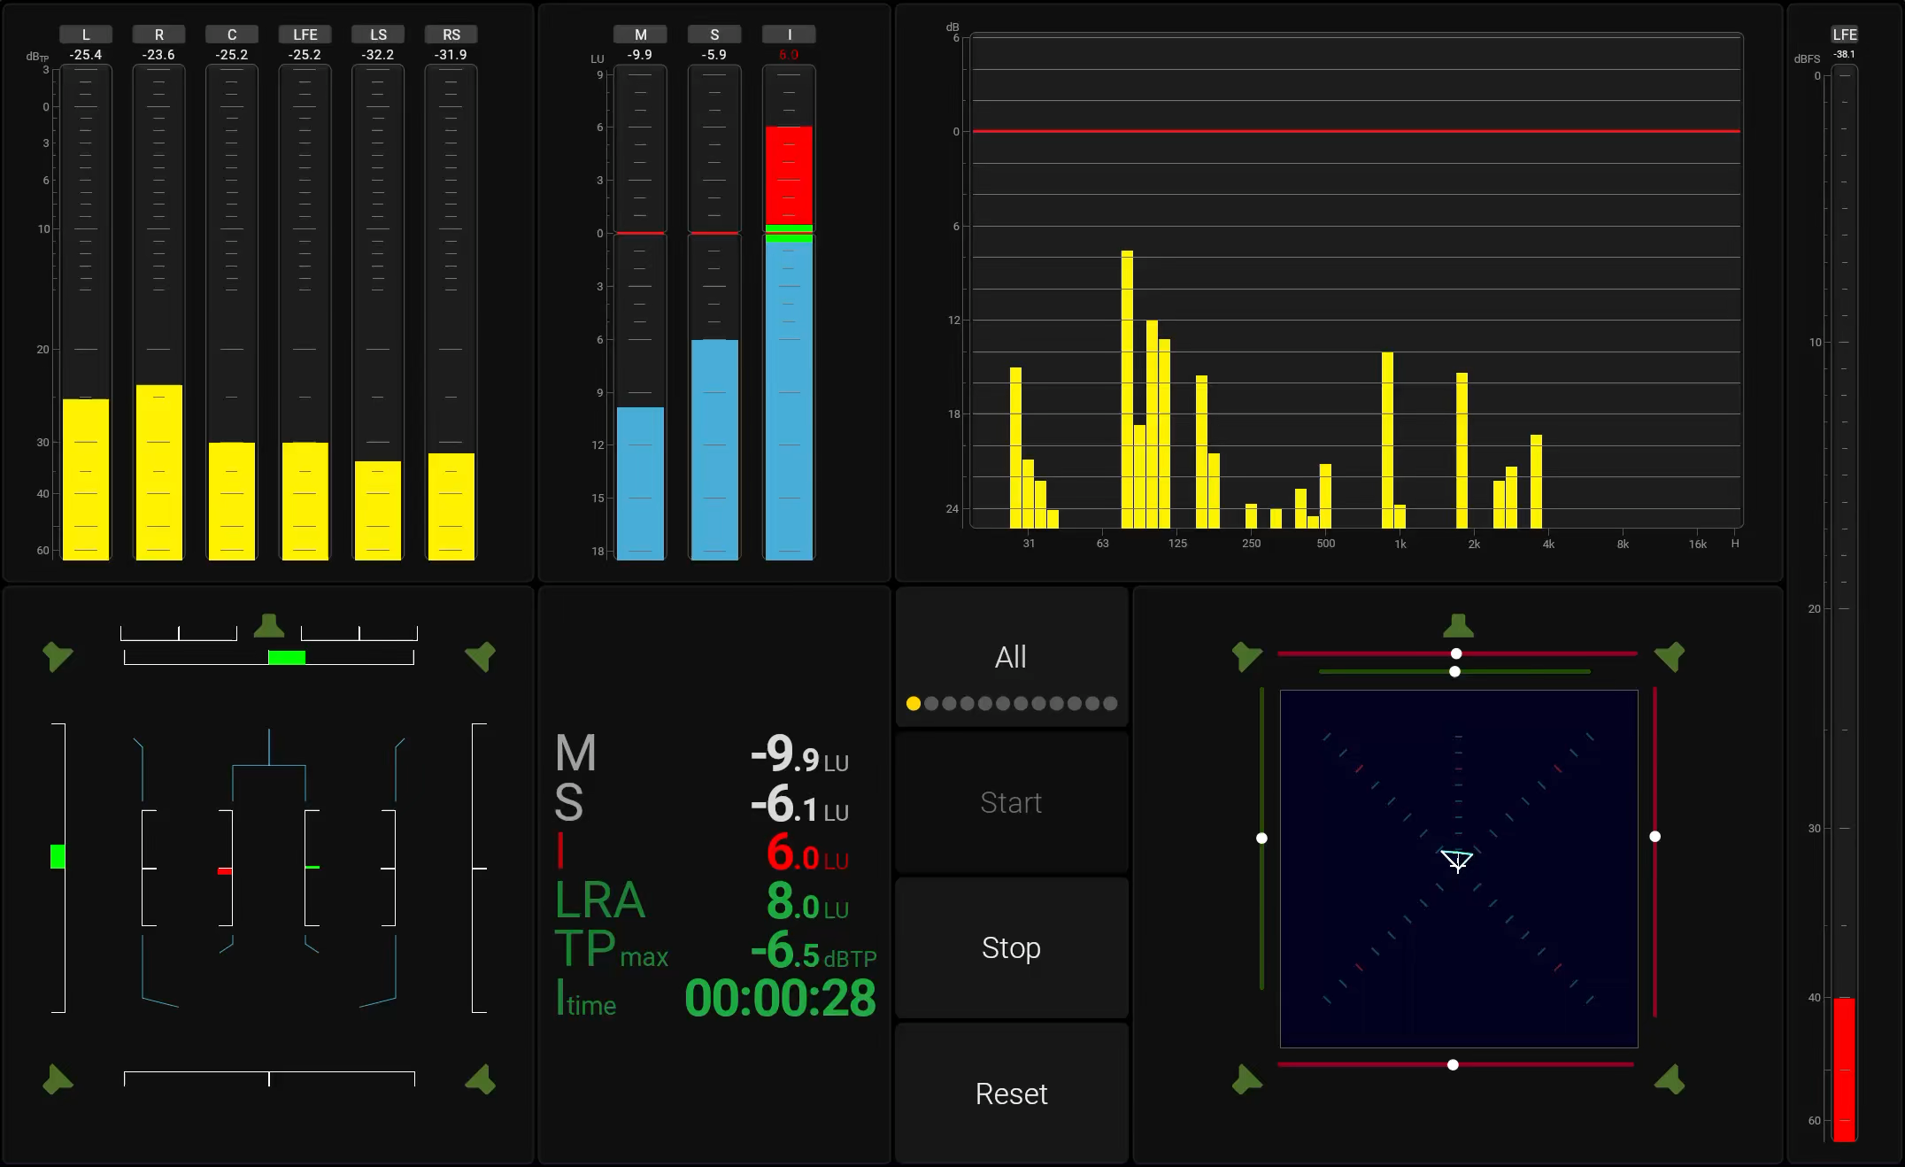
Applications
Broadcast: Live Sports, Music, News
Versatile connectivity: Supports Ravenna, AES67, and ST2110 networks for seamless integration in modern broadcast environments.
Comprehensive monitoring: Equipped with robust loudness tools to handle live broadcasts from sports and music to news.
Trusted compliance: Ensures adherence to international loudness standards, delivering consistent, high-quality audio.

Slide 29
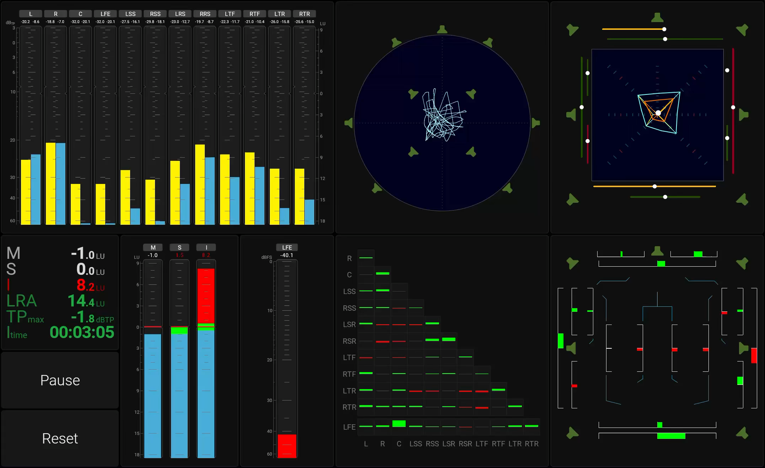
Applications
Post Production and Cinema
Immersive-ready: Advanced metering tools tailored for immersive audio and dialog intelligibility on Dante® audio networks.
Standards compliance: Simplifies adherence to international loudness regulations such as EBU R128 and ATSC A/85 (CALM).
Delivery assurance: Meets streaming platform requirements, including specifications from Netflix.

Slide 30
Applications
Installed Sound
AoIP integration: Designed for installations in stadiums, theaters, houses of worship, and event spaces.
Comprehensive toolkit: Provides a full suite of metering instruments for professional audio monitoring.
Audience focus: Empowers engineers to optimize performance and deliver an enhanced listening experience.

Slide 31
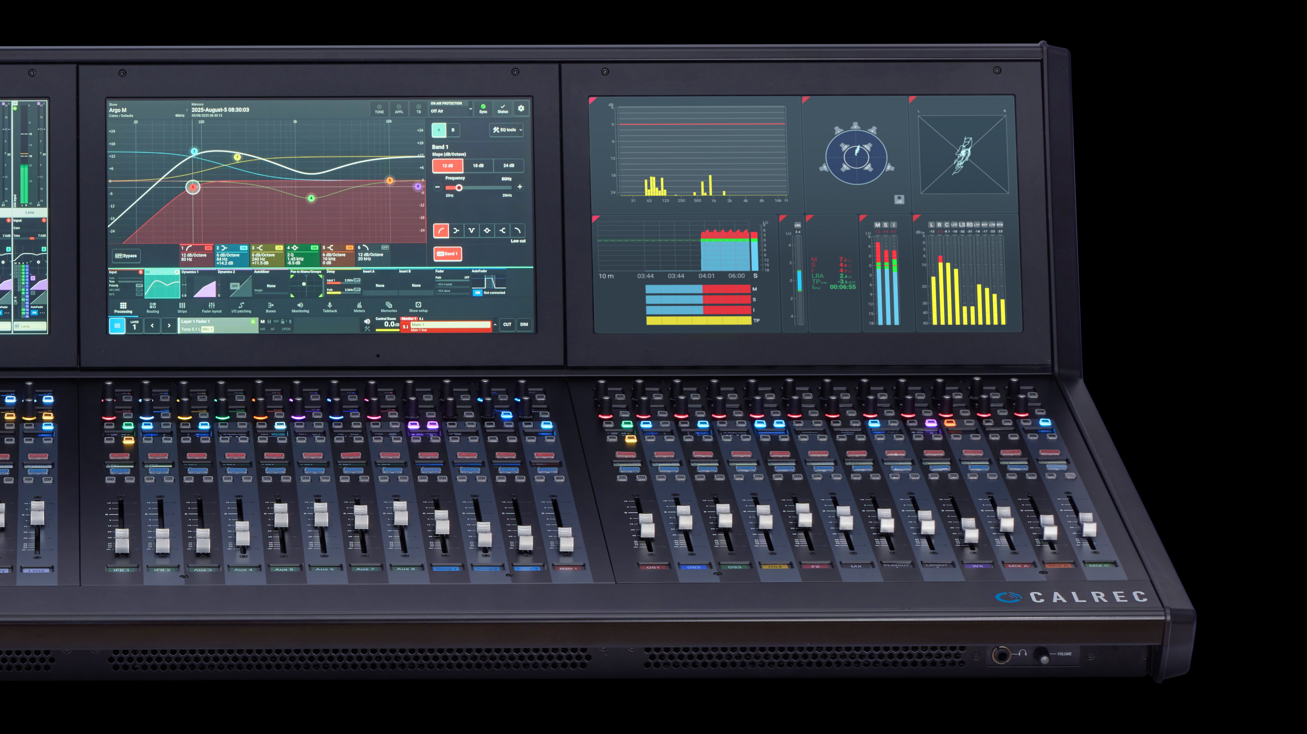
Applications
OEM: Broadcast Consoles
Screenless flexibility: A compact, display-independent platform that integrates seamlessly while leaving full visual control to console manufacturers.
Future-ready performance: Equipped with powerful CPU and RAM resources to handle loudness, dialog intelligibility, and immersive audio standards.
Trusted integration: Standardized I/O, network connectivity, scalable licensing, and RTW’s proven quality ensure reliability without compromise.

Slide 32
Market
Licenses
Super simple licensing structure
Basic version contains what most need
Licenses:
  Surround and Immersive Instruments
  Monitor Control
  External Logging and Integration
  Dialog Intelligibility
  Extra Screen Displays
Pricing equals that of a classic TM with relevant tools

Slide 33
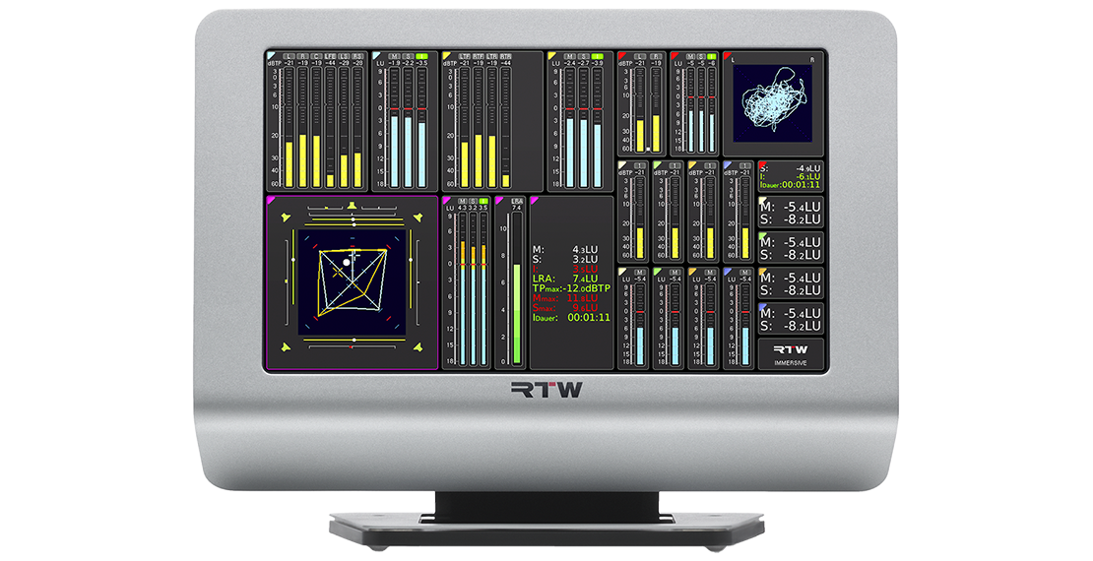
Status
Classic TouchMonitor TM7/TM9?
Still Available
Including OEM Versions

Slide 34

Read More
Product Page
TMxCore Product Page

